Slide 1
ZINDAGI REBORN
Team - Noob Masters
Ankit Kumar Harshit Mishra
Debargha Guha Neogi

Slide 2
PROBLEM STATEMENT

Slide 3
Problem Statement
Globally, close to 800,000 people die from suicide every year. That’s one person every 40 seconds. This shows, suicide is a big problem which needs to be tackled in an appropriate manner. Despite the efforts from many international organisations, like WHO the suicide rates are increasing day by day.
Social Media has been stigmatised to influence young people to commit suicide, but people’s expression on social media is carefully analysed then it can be used to determine the chances of committing suicide, thus preventing such actions.

Slide 4
PROPOSED SOLUTION

Slide 5
Proposed Solution
We will try to deploy a Natural Language Processing Model that would detect any suicidal thoughts in a person by analysis their social media feeds. For the purpose of demonstration we would use this model in a self-built social media platform. The same model can be used in other major Social Media Platforms like Twitter and Facebook where it could analyse the tweets or posts of individuals to detect any suicidal thoughts. After in-place detection, the system will automatically raise an alert to the close aids of the person or police or counselling team depending on the level of risk.

Slide 6
PROPOSED ARCHITECTURE

Slide 7
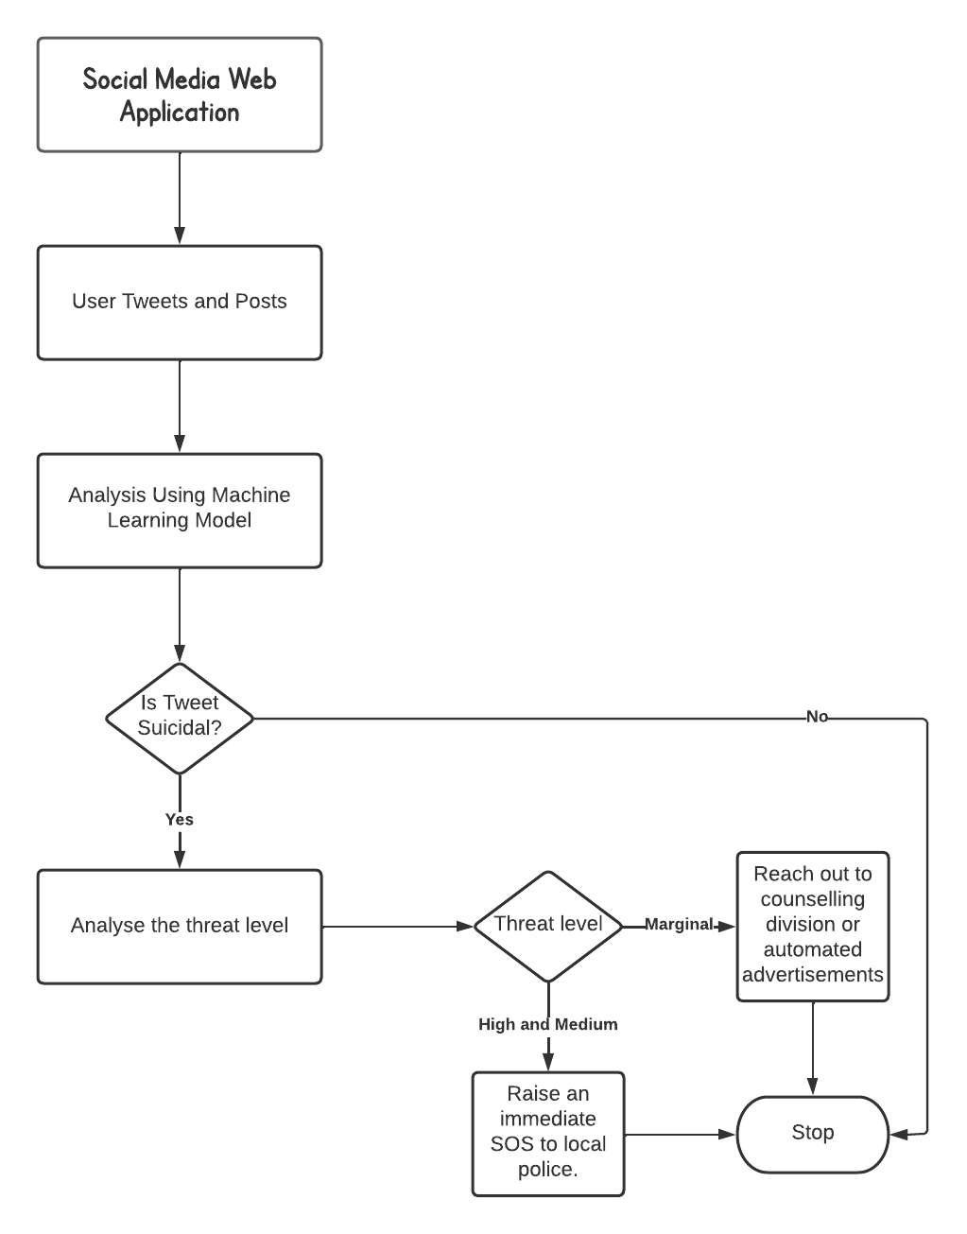

Slide 8
SCOPE OF PROJECT

Slide 9
Scope of the Project
This project aims at working in application layer of various social media platforms. It can make use of non-conversational platforms like Facebook, Twitter, Instagram and more to extend aid and required help for those in need.
The project also aims at partnering with various NGOs who can help provide assistance to those in need.

Slide 10
THANK YOU!

